Slide 1
Microprocessor and Computer Architecture(ELX 301)
BIT 3rd Semester
Er. Suraj Basant Tulachan
Assistant Professor

Slide 2
Unit 4: Basic Computer Architecture and
Micro - operations
Outline:
  4.1 History of Computer Architecture
  4.2 Overview of Computer Organization
  4.3 Memory Hierarchy
  4.4 Micro-operations
  4.5 Arithmetic Micro-operations
  4.6 Logic Micro-operations
  4.7 Shift Micro-operations
  4.8 Arithmetic Logic Shift Unit

Slide 3
History of Computer Architecture
  First Generation(1940-1950)
  First Generation used vacuum tubes.
  Occupies large space.
  Consumes more power.
  Uses low level language.
  ENIAC, UNIVAC- First Commercial Computer
  John von Neumann architecture:-Goldstine and Von Neumann developed the concept of storing in memory.

Slide 4
History of Computer Architecture
  Second Generation(1950-1964)
  Vacuum tubes replaced by Transistor.
  William Shockley, John Bardeen, Walter Brattain invented transistor.
  Improved Reliability.
  Reduces Size.
  First Operating System.
  Handled one Program at a time.
  Used High Level Language.
  Floating Point Arithmetic.

Slide 5
History of Computer Architecture
  Third Generation(1964-1971)
  Third Generation Computer uses Integrated Circuit (IC).
  Single integrated circuit (IC) is made up of many transistors and placed on silicon chips called Semiconductor.
  Increased Speed and efficiency of computer.
  Small in Size, more reliable.
  Cheap and Affordable.
  High-level programming languages such as FORTRON-II to IV, COBOL, and PASCAL PL/1.
  Many application can be run at the same time.

Slide 6
History of Computer Architecture
  Fourth Generation(1971-1980)
  Fourth Generation Computer uses Microprocessor.
  Thousand of Integrated circuit (IC) are built on single chip.
  Increased Speed and efficiency of computer.
  Small computers became powerful.
  Linking computers together and development of Internet.
  High Level programming language such as C, C++, Java.
  Development & Use of Graphical User Interface(GUI)

Slide 7
History of Computer Architecture
  Fifth Generation(Present & Beyond)
  Fifth Generation is based on Artificial Intelligence(A.I).
  Uses Ultra Large Scale Integration (ULSI) technology.
  Parallel Processing Hardware and super conductors.
  Quantum computation, Molecular and Nano Technology brings emerging change.
  Fifth Generation Computing develop devices to respond/understand natural language input and capable to learn and organize on self.

Slide 8
Overview of Computer Organization
  Computer Organization refers to the Physical component of computers and their interconnection.
  Computer Organization deals with the structure of computer and how computer works.
  Computer Organization explains the low level design.
  Defines the structural relationship between parts of computer system.

Slide 9
Micro-Operations
Micro-operations
Register is storage device. It stores the data, performs operation and transfer.
The elementary operations on the data in registers are called microoperations.
Alternatively we can say that an elementary operation performed during one clock pulse on the information stored in one or more registers is called micro-operation.
The result of the operation may replace the previous binary information
of the register or may be transferred to another register.
Register Transfer Language (RTL) can be used to describe the (sequence of) micro-operations.

Slide 10
Micro-Operations
The microoperations most often encountered in digital computers are classified into 4 categories:
i) Register transfer microoperations
ii) Arithmetic microoperations
iii) Logic microoperations
iv) Shift microoperations
Register transfer microoperations
Registers are designated by capital letters, sometimes followed by numbers (e.g., A, R13, IR).
Often the names indicate function:

Slide 11
Micro-Operations
Information transfer from one register to another is described in symbolic form by the replacement operator.
The statement “R2 R1” denotes a transfer of the content of the R1 into register R2.
MAR PC IR | memory address register program counter instruction register

Slide 12
Micro-Operations
Arithmetic microoperations
The basic arithmetic microoperations are
Addition
Subtraction
Increment
Decrement
The additional arithmetic microoperations are
Add with carry
Subtract with borrow
Transfer/Load

Slide 13
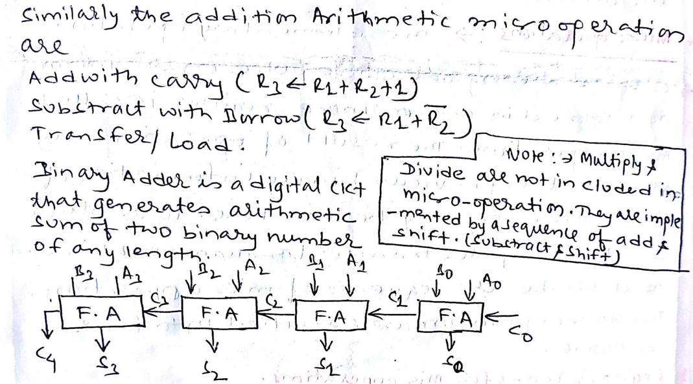
Micro-Operations

Slide 14
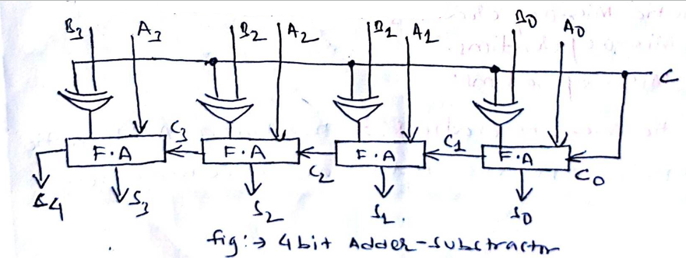
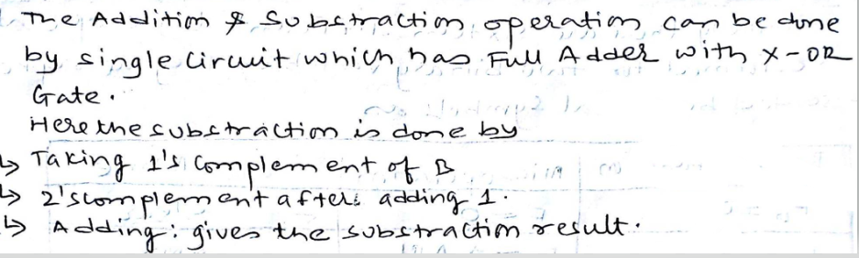
Micro-Operations

Slide 15
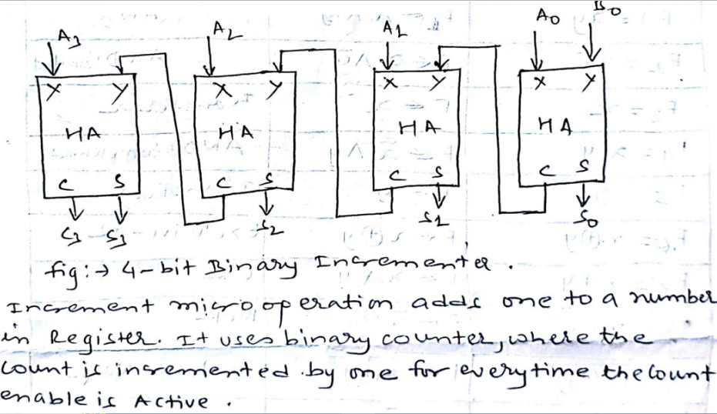

Micro-Operations

Slide 16
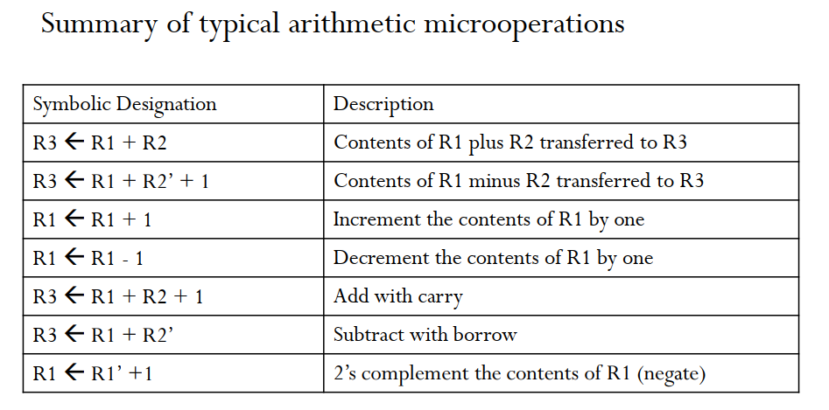
Micro-Operations

Slide 17
Micro-Operations
Logic microoperations
Logic microoperations are bit-wise operations, i.e., they work on the individual bits of data.
Useful for bit manipulations on binary data and for making logical decisions based on the bit value.
There are, in principle, 16 different logic functions that can be defined over two binary input variables.
However, most systems only implement four of these
– AND (/\), OR (\/), XOR (⊕), Complement/NOT

Slide 18
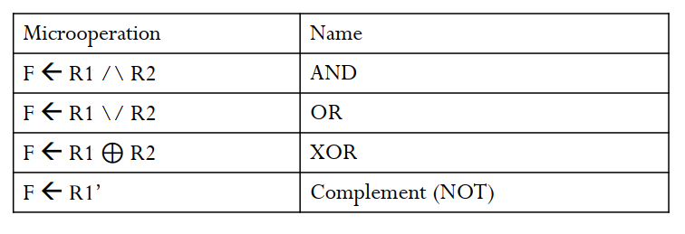
Micro-Operations
Fig: Logic Micro operations

Slide 19
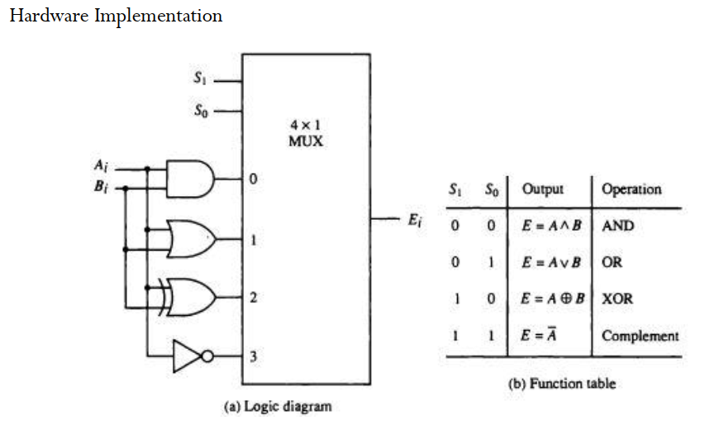
Micro-Operations

Slide 20
Micro-Operations
Shift micro operations
The operation that changes the adjacent bit position of the binary values stored in the register is known as shift micro operation.
They are used for serial transfer of data.
The shift micro operations are classified into 3 types:
i) Logical shift
ii) Circular shift
iii) Arithmetic shift

Slide 21
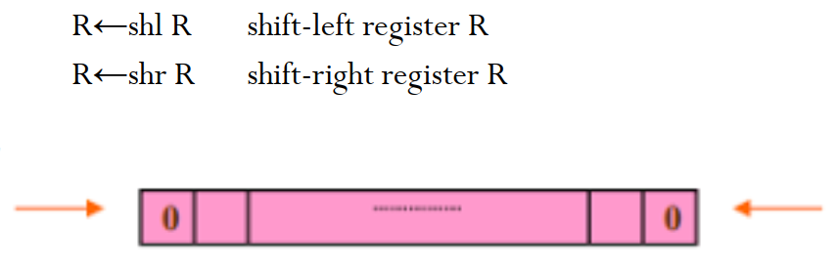
Micro-Operations
Logical shift
A logical shift transfer 0 through the serial input.
It can be defined in RTL by:

Slide 22
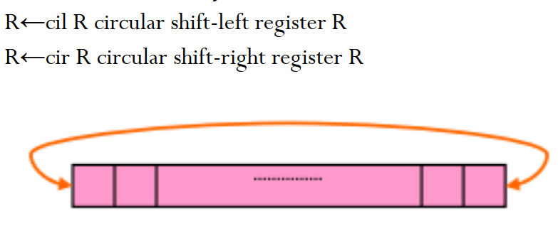
Micro-Operations
Circular shift
A circular shift rotates the bit from one end of the register to another end of the register.
It can be defined in RTL by:

Slide 23
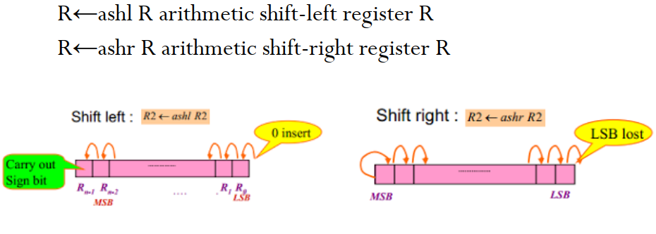
Micro-Operations
Arithmetic shift
It shifts signed-binary numbers left or right.
For shift left the content of the register is multiplied by 2 whereas For shift right the content of the register is divided by 2.
The arithmetic shift must leave the sign bit unchanged.
It can be defined in RTL by:

Slide 24
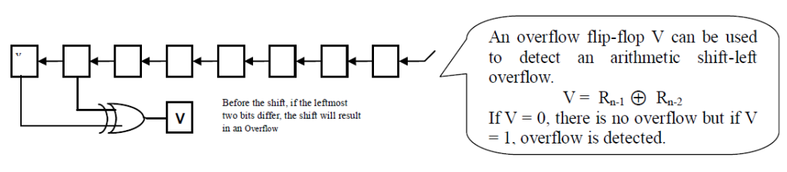
Micro-Operations
Overflow case during arithmetic shift left
If a bit in R_{n-1} changes in value after the shift, sign reversal occurs in the result.
This happens if the multiplication by 2 causes an overflow.
Thus, the left arithmetic shift operation must be checked for the overflow: an overflow occurs after an arithmetic shift-left if before shift R_{n-1}≠R_{n-2}.

Slide 25
Arithmetic Logic Shift Unit
Arithmetic logic shift unit is a digital circuit that performs arithmetic calculations, logical manipulation, and shift operation.
It is often abbreviated as ALU. The above figure shows the one stage of the arithmetic logic shift unit.
The block diagram of ALU includes one stage of the arithmetic circuit, one stage of the logic circuit, and one 4*1 multiplexer.
The subscript i designates a typical stage.

Slide 26
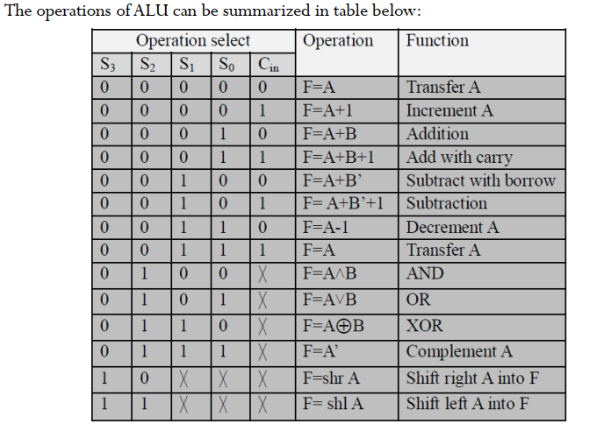
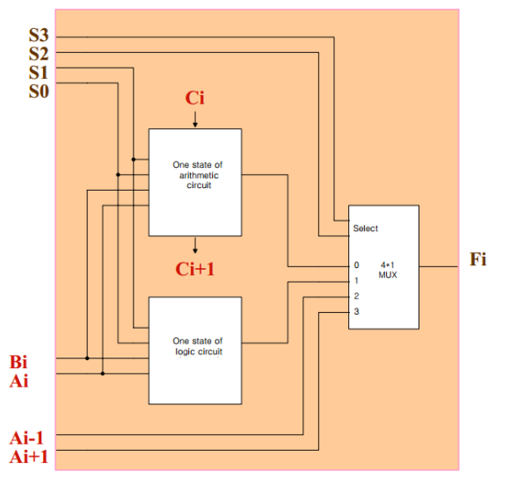
Arithmetic Logic Shift Unit

Slide 27
Arithmetic Logic Shift Unit
Inputs Ai and Bi are applied to both the arithmetic and logic units.
A particular microoperation is selected with inputs S1 and S0.
A 4 x 1 MUX selects the final output.
The two inputs of the MUX are received from the output of the arithmetic circuit and logic circuit.
The other two are A_{i-1} for the shift-right operation and A_{i+1} for the
shift left operation.
The circuit is repeated n times for n-bit ALU.
The output carry Ci+1 is connected to the input carry C_{in}.
In every stage the circuit specifies 8 arithmetic operations, 4 logical operations, and 2 shift operations, where each operation is selected by the five variables S3, S2, S1, S0, and C_{in.}

Slide 28
THANK YOU

